Slide 1

Water Quality Prediction

Slide 2


Dataset

Slide 3

Statistics

Slide 4
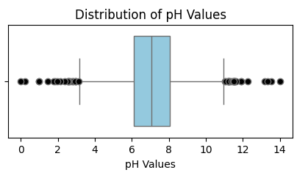
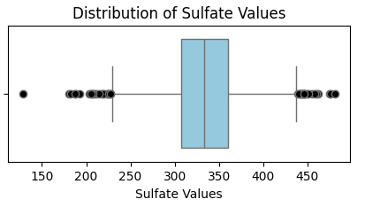
Frequency Distribution

Slide 5
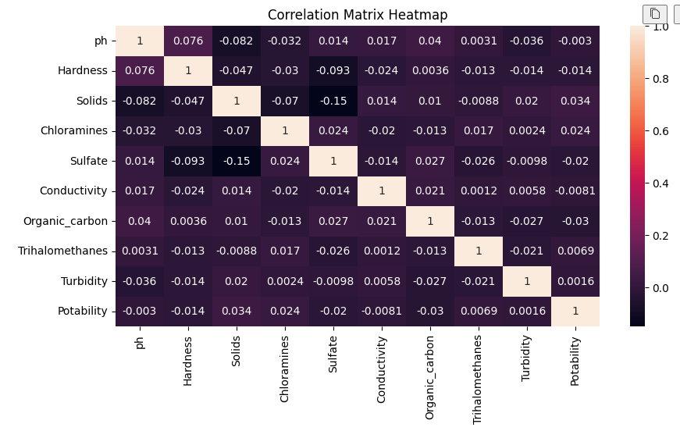
Correlation Matrix Heat-Map

Slide 6
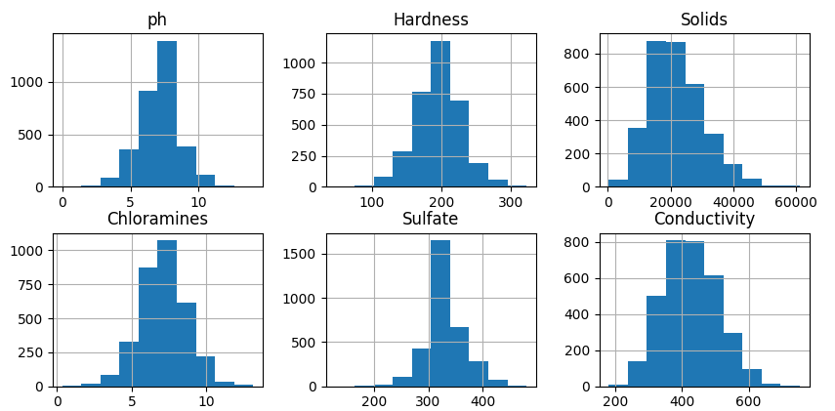
Histogram

Slide 7
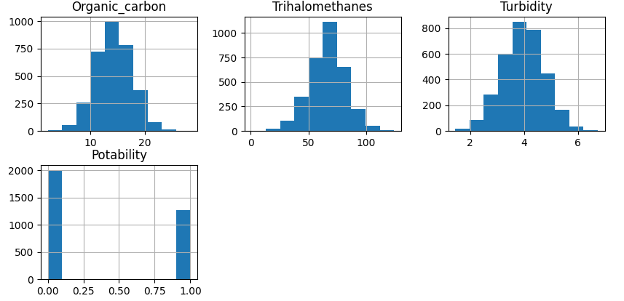
Histogram

Slide 8
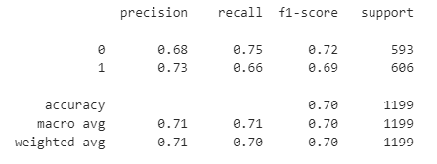
Accuracy

Slide 9
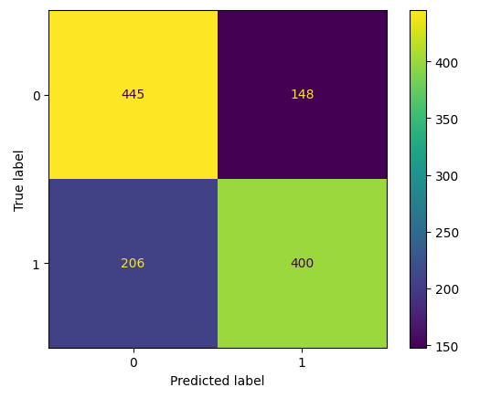
Confusion Matrix

Slide 10

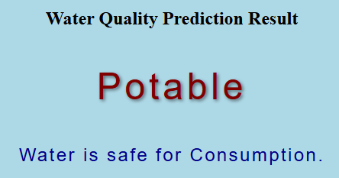
Web Application

Slide 11

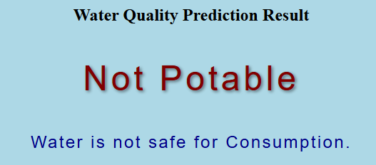
Web Application

